Slide 1
Hand Hygiene
Part One - Why and When

Slide 2
Hand Hygiene
What is hand hygiene?
  Hand Hygiene means cleaning your hands by using either handwashing (washing hands with soap and water), antiseptic hand wash, antiseptic hand rub (i.e., alcohol-based hand sanitizer including foam or gel).
Why practice hand hygiene?
  Cleaning your hands reduces:
    The spread of potentially deadly germs to residents
    The risk of healthcare provider colonization (meaning, having the germ in or on the body without causing infection) or infection caused by germs picked up from the resident
Hand hygiene is a critically important infection prevention measure. Each year between 1 and 3 million residents of nursing homes or skilled nursing facilities develop healthcare acquired infections and as many as 380,000 people die of these infections.
  Studies show that some healthcare providers practice hand hygiene less than half of the times they should.

Slide 3
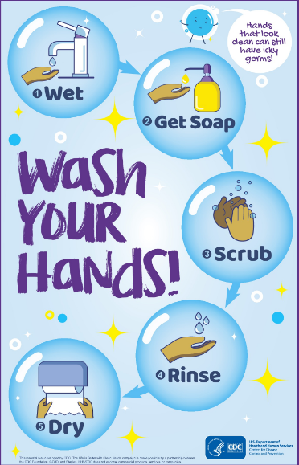
Hand washing
Wash your hands with soap and water whenever:
  They are visibly dirty
  Before eating, and
  After using the restroom
  During Routine Resident Care:
    When hands are visibly soiled
    After caring for a resident with known or suspected infectious diarrhea (i.e., Norovirus)
    After known or suspected exposure to spores (i.e., C. diff)

Slide 4
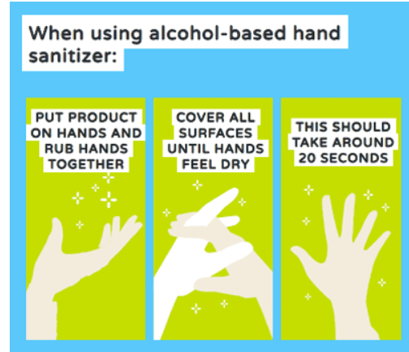
Use of Alcohol-Based Hand Rub
An alcohol-based hand sanitizer (with at least 60% alcohol) is the preferred method for cleaning your hands when they are not visibly dirty. Use it:
  Immediately before touching a resident
  Before performing an aseptic task (e.g., placing an indwelling device) or handling a device that is left inside the body (i.e., urinary catheter)
  Before moving from work on a soiled body site to a clean body site on the same resident
  After touching a resident or the resident’s immediate environment
  After contact with blood, body fluids or contaminated surfaces
  Immediately after glove removal
Clean Hands Count for Safe Healthcare | Features | CDC (iiab.me)

Slide 5
Alcohol-Based Hand Rub
Alcohol-based Hand rub:
  Technique matters, use the right amount of alcohol-based hand sanitizer product to clean your hands (see manufacturer’s instructions)
    How well the alcohol-based hand sanitizer works depends on the amount applied to the hands
These areas are most often missed by healthcare providers when using alcohol-based hand sanitizer:
  Thumbs
  Fingertips
  Between fingers

Slide 6
References
CDC Hand Hygiene in Healthcare Settings, Show Me the Science, Last Reviewed: November 21, 2023, https://www.cdc.gov/handhygiene/science/index.html , Accessed 2-3-2024
CDC Hand Hygiene in Healthcare Settings, Healthcare Providers, Last Reviewed: January 8, 2021,
https://www.cdc.gov/handhygiene/providers/index.html , Accessed 2-3-24

